Slide 1



OPTIMIZING SUPPLY CHAINS USING POWER BI
BY, CHARVI BAYANA

Slide 2

Learning Objectives
Understanding how data analytics improves supply chain efficiency
Learning how to monitor a supply chain from beginning to end using power bi
Understanding data driven recommendation
Learning the building block of every supply chain from supplier, to manufacturing to inventory management and finally customers
GOAL
Source :
www.freepik.com/

Slide 3
Tools and Technology used
Power BI – Data visualization and interactive dashboard
Excel / CSV dataset – Raw data cleaning and preprocessing
Kaggle – used to find a suitable dataset
DAX (data analysis expressions) – used to create new columns like profit
Why power BI:
Real-time data visualization for better supply chain monitoring
Custom dashboards to track key metrics like inventory, turnover, supplier performance, and transportation costs.

Slide 4
Methodology
Data Collection – Gathering supply chain datasets form Kaggle.
Data Cleaning - duplicates, handles missing values, standardized formats.
Data modeling – Structured data into key categories: inventory, Manufacturing, supplier and supply chain.
Analysis and insights - Identified trends, inefficiencies, and optimization opportunities.
Dashboard Creation - Developed interactive visual sin Power BI.

Slide 5
Problem Statement:
Supply chains are complex, with multiple stakeholders, from suppliers to customers. Inefficiencies in inventory management, manufacturing delays, and logistics costs impact profitability and customer satisfaction.
Challenges in Supply Chain Performance
High inventory cost due to poor stock management
Delays in manufacturing and supplier lead times
Increasing logistics expenses from inefficient transportation routes
Lack of real-time visibility into supply chain operations

Slide 6
Solution:
A COHESIVE POWER BI DASHBOARD
Contains:
Executive summary: KPI’s, performance trends and insights
Manufacturing analysis: (eg: production volumes by manufacturing times)
Supplier analysis: (eg: shipping costs of suppliers)
Inventory analysis: (eg: stock levels by product type)
Overall dashboard: summary

Slide 7
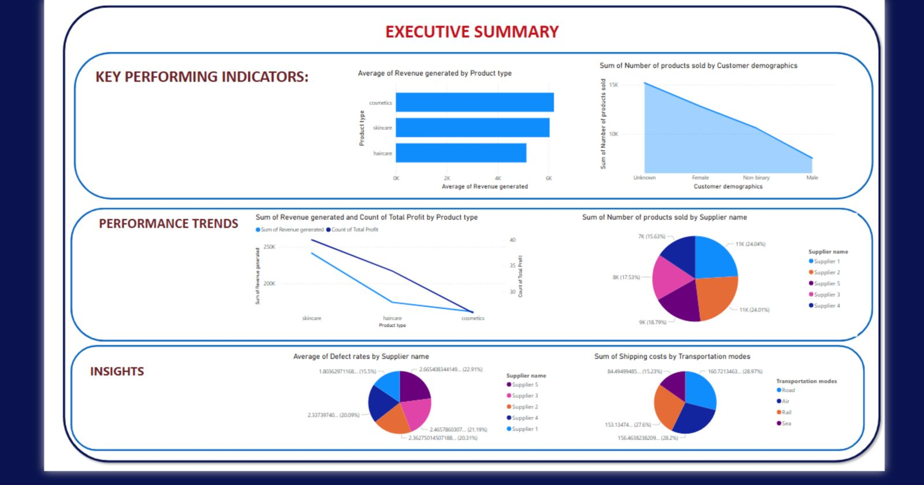
Screenshot of Output:
It can be concluded that most of the customer base is of females, so the next products would also be popular is marketed towards the bigger demographic

Slide 8
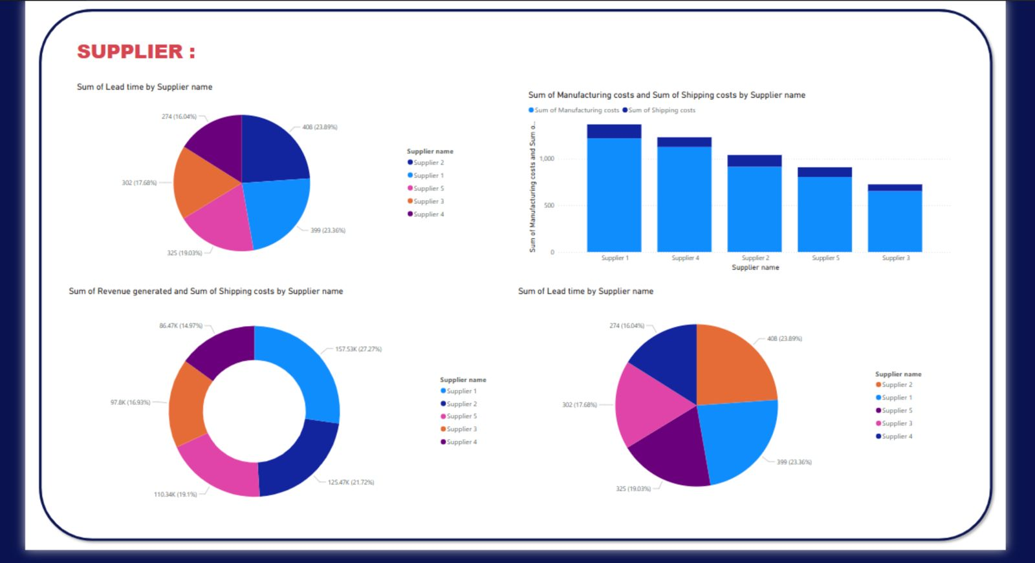

Slide 9
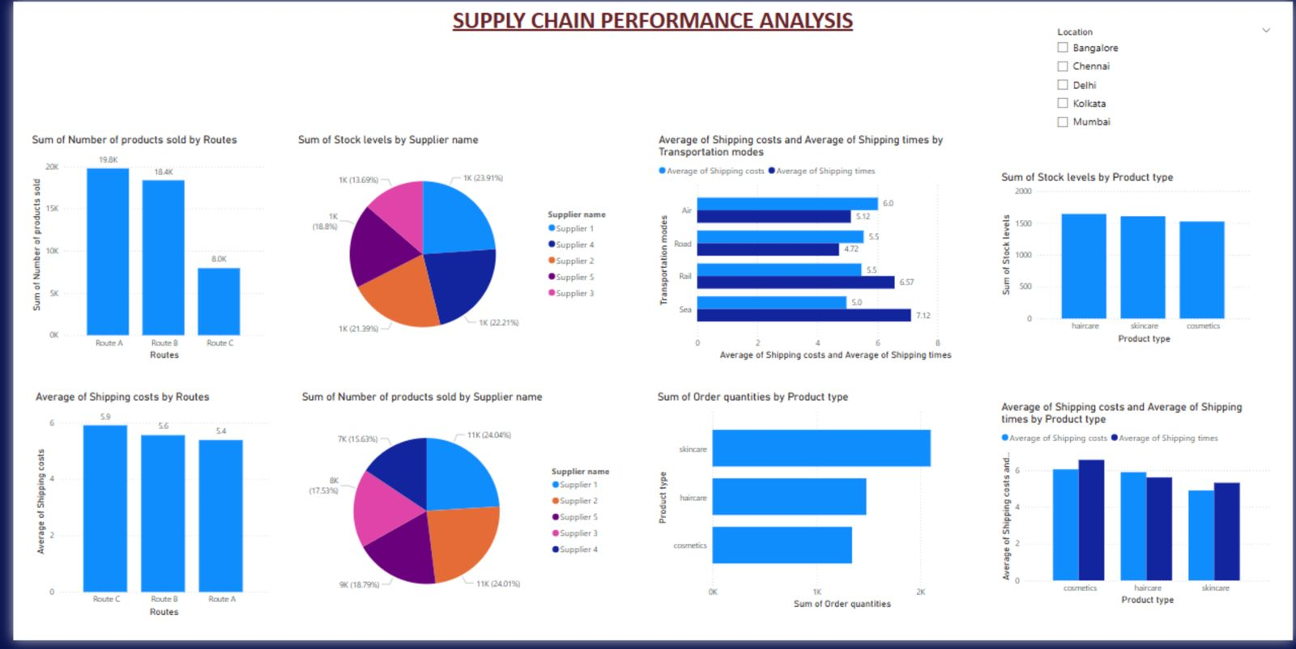
Can be seen that skincare is the most selling product

Slide 10
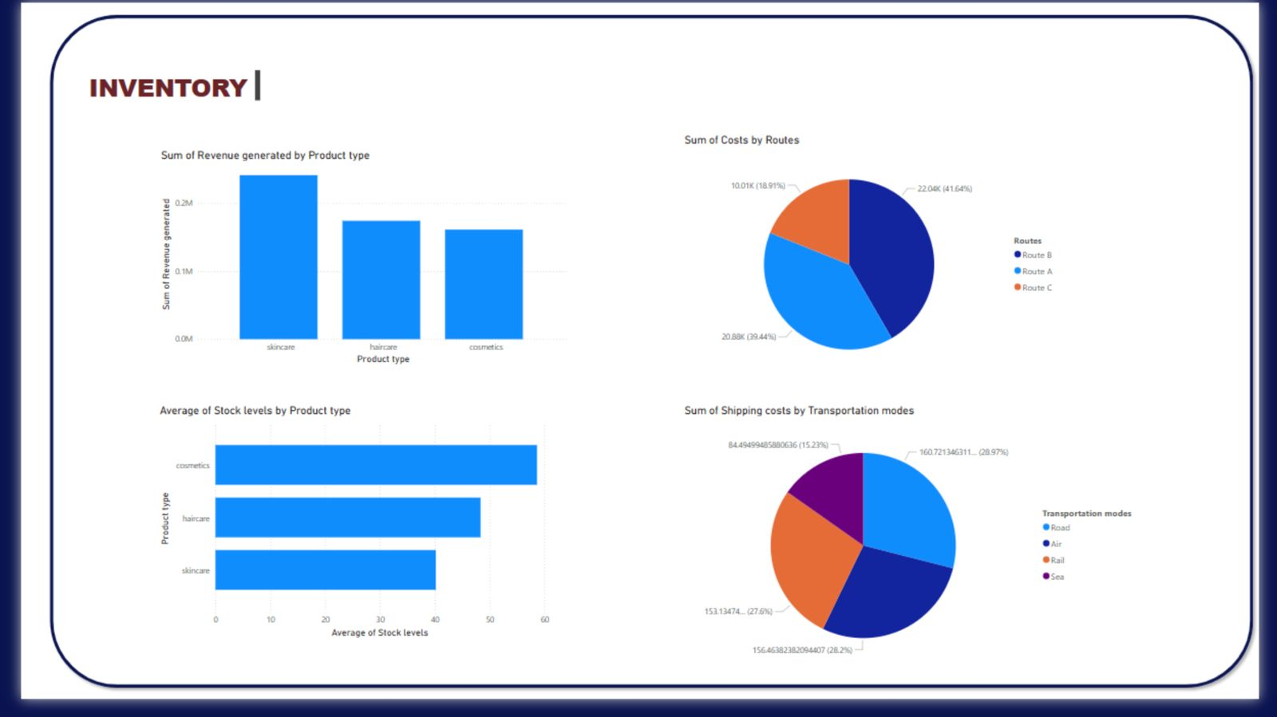

Slide 11
Conclusion:
Key takeaways:
Data – driven decision making enhances supply chain efficiency.
Optimizing inventory levels reduces excess stock costs.
Choosing the right suppliers and logistics routes lower expenses
Power BI enables real time monitoring for proactive management
2) Business impact:
Cost reduction: lower transportation and inventory expenses
Improved Customer Satisfaction: Faster delivery and fewer stockouts
Operational Efficiency: Better supplier coordination and reduced lead times.
Scalability: The dashboard can be expanded for more business units and locations.
Harnessing data analytics in supply chain management drives efficiency and profitability. With continuous improvements, companies can transition from reactive problem-solving to proactive strategic planning.

